Slide 1
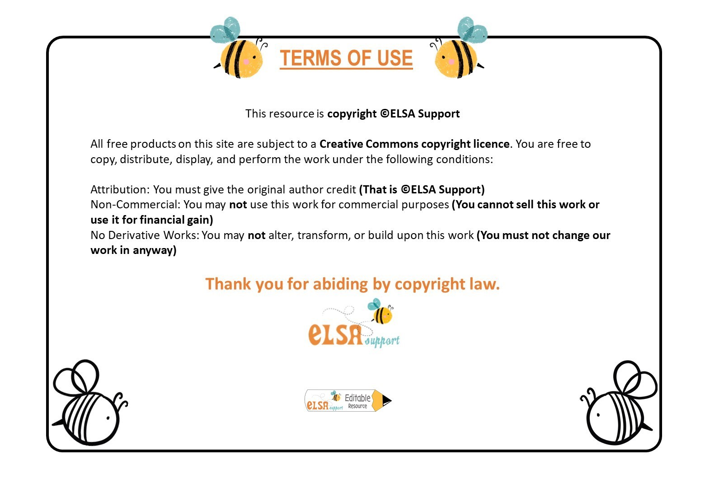
www.elsa-support.co.uk

Slide 2
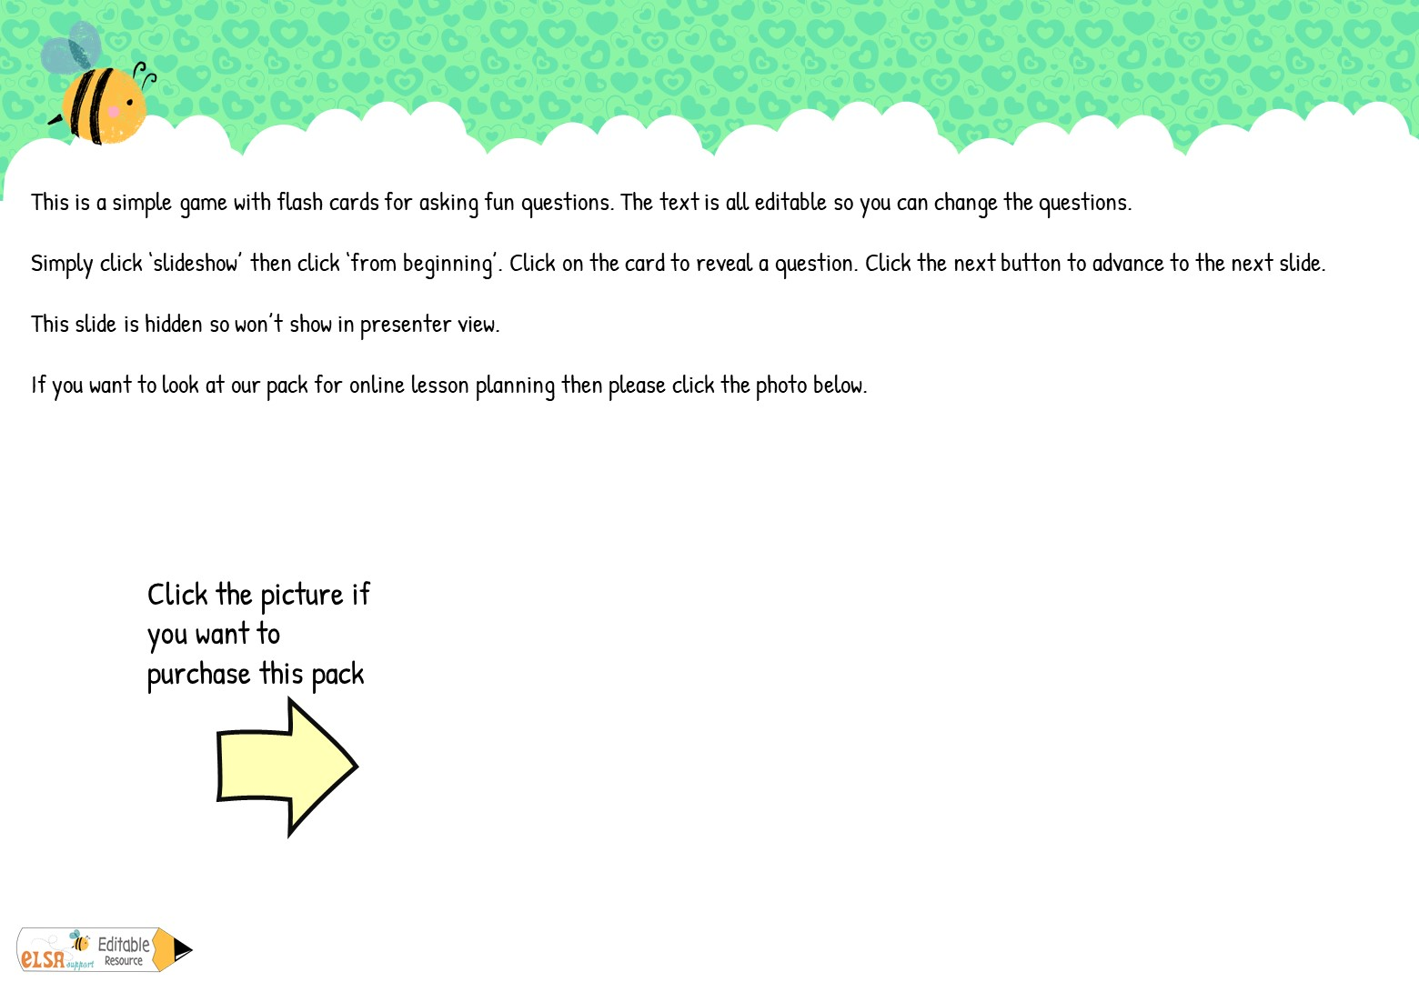
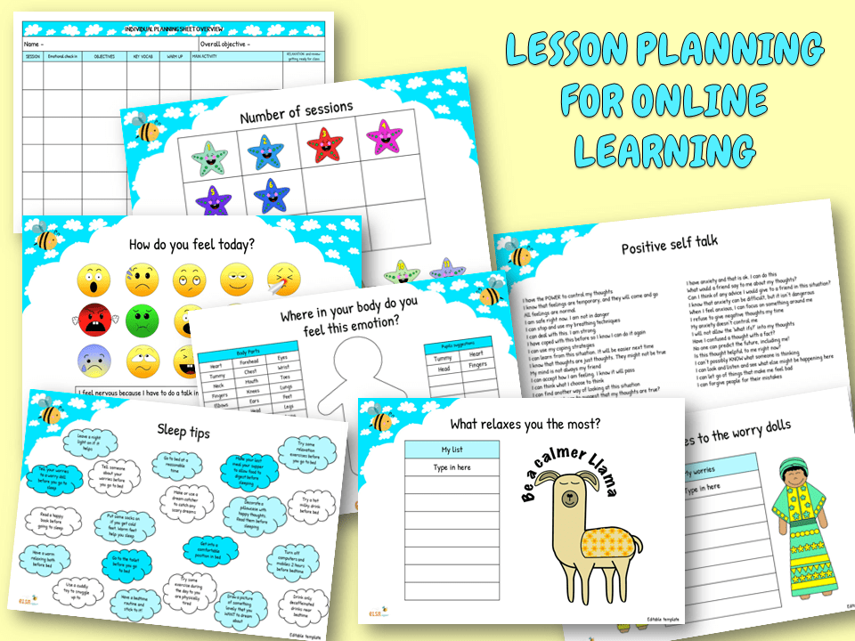

Slide 3

PLAY

Slide 4

fruits
Give me 5
Give me 5…
Give me 5…
Give me 5…
vegetables
animals
Ice cream flavours
Give me 5…
Give me 5…
drinks
Give me 5…
pizza toppings
sports
Give me 5…
games
NEXT

Slide 5

pets
Give me 5…
Give me 5…
Give me 5…
Give me 5…
farm animals
wild animals
colours
Give me 5…
Give me 5…
smells
Give me 5…
emotions
superpowers
Give me 5…
movies
NEXT

Slide 6
Things you see at Halloween
Give me 5…
Give me 5…
Give me 5…
Give me 5…
Things you see at Christmas
Things you find on a beach
Things you find in the countryside
Give me 5…
Give me 5…
Things you see in spring
Give me 5…
Things you see in the sky
Things you find in a bathroom
Give me 5…
Things you find in a kitchen
NEXT

Slide 7
Boy’s names
Give me 5…
Give me 5…
Give me 5…
Give me 5…
Girl’s names
Ways to travel
Things found in the sea
Give me 5…
Give me 5…
Things that make you happy
Give me 5…
Presents you have received
Ways to relax
Give me 5…
Ways to be helpful

